Slide 1
Consumer choice
Regis University Practicum I & II
Carla Gonzales
Dec. 7, 2016
Notes:
My Practicum project is on choice modeling

Slide 2
Agenda
Overview
Case Study
Experiment
Data Preparation
Implementation
Analysis
Case Study Results
Conclusion
Challenges and Next Steps
References
Notes:
This is the agenda of topics I will cover in my presentation for my practicum product, each topic in be reviewed in detail. To start, let’s look at the overview

Slide 3
Introduction
Overview:
This Practicum project attempts to predict consumer behavior using choice modeling techniques on a fictitious case study about orange juice beverages
The project uses survey data to determine which attributes consumer’s value when making purchasing decisions
Notes:
This presentation will address my project on consumer choice and my study of survey analysis for Data Science Marketing. The project will demonstrate two different research methods used to evaluate consumer choice decision making.

Slide 4

Consumer vs. Customer
Overview:
Consumer vs. Customer
Consumers are product users
Customer are product buyers
Decision Makers: An individual, group or institution –anyone who has the responsibility to make the decision at hand (purchasing power)
The focus is on Consumers
Both consumers and customers can be decision makers and can have an affect on what products/services to buy
Factors that influence consumer choice
Personal values
Preferences or tastes (differ widely)
Ability to acquire goods (income or price constraints)
Notes:
Before I go into the detail about my project – I want to give you an overview of consumer choice modeling and explain:
1) The difference between customer and consumer
2) who are Decision Makers (they responsible for the purchase decision)
3) The key factors that influence purchase decisions

Slide 5

Choice Modeling
Overview:
Set of tools to predict the choice behavior of a group of decision-makers in a specific choice context
Used to support Decision Makers in fields such as transportation, health economics, environmental analysis and marketing
Marketing Science uses this method to determine whether consumers will purchase a product based on the product’s attributes
There are different types of choice modeling. The most preferred model: Conjoint
Notes:
Choice Modeling is
The primary technique for analyzing and predicting consumer behavior in data science marketing
Choice modeling helps to determine the relative influence:
Between different attributes of alternatives
Identify the characteristics of decision makers when they make choice decisions.
This method offers the most realistic understanding of consumer buying behavior
In other words
Choice models focus on understanding the alternatives as must haves trade-off
Where as other models consider consumer preferences as options

Slide 6

Conjoint
Overview:
Multivariate technique that quantitatively measures the importance of different attributes
Consumers are presented sets of possible products (alternatives) via a survey and asked to make trade-offs by selecting which one they would prefer
Ideal for optimizing new product designs by identifying the most possible features
Most popular conjoint methods are:
Choice Base Conjoint (CBC): use product profiles to estimate underlying utilities or part-worths
Can use potential customers
Discrete Choice Conjoint Models: present experimental replications of the market with the focus on making accurate predictions regarding consumer preferences
Also known as "stated preference research" or alternative specific choice-based design
Can use current and potential customers
Notes:
Conjoint multivariate techniques measure the value the market places on each feature of your product
and predicts the value of any combination of features.
conjoint analysis is, at its essence, all about features and trade-offs.
Conjoint Analysis is the ability to develop market simulation models that can predict consumer behavior to product changes.
Choice-Based/Discrete-Choice Conjoint Analysis are basically the same

Slide 7
Key Terms
Introduction:
Respondents: are the consumers participating in the survey
Attributes /Features: (independent variable): is a characteristic of a product such as color.
Levels: are the elements of an attribute such as yellow or blue. Define at least two levels for each of the attributes.
Tasks: are the number of pages respondents see within the survey
Concepts: are the number of choice options (combined attribute levels) shown on a page
Utilities /Part-worth: a measured values that is produced for each group of respondents in order to summarize the choices made by those individuals. It can be used to determine how important an attribute is to the purchase or choice process and in “market simulations”
Notes:
There are key terms that are used in conjoint analysis and in preparing survey.

Slide 8
The state of OJ
Case Study:
…is not looking good
Americans are turning away from orange juice due to its scant nutritional value
Orange juice sales are at an all time low. Sales have been down 13% for the past four years, (Nielsen rating).
Buyers want healthy, 100% juice products, drinks fortified with extra vitamins and minerals, or interesting new flavor combinations such as carrot, strawberry and kiwi to tantalize taste buds.
Orange producers have also been battling a bacterial disease that has been wiping out their groves.
Notes:
Now that I covered the overview of conjoint – I want to dive into my case study
- OJ has been considered part of an All-American breakfast (stable) but this has been changing and OJ is losing it breakfast appeal
- Sales down
Consumers confidence is low due to the high sugar content in OJ (same as soda)
OJ Producers are struggling to find ways to get fight crop issues and boost sales
Hopeful with Nutritional additives

Slide 9
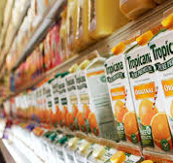
Data science marketing Problem
Case Study:
Case Study Scenario: A Marketing Executive wants to help sway management to launch a new orange juice beverage. This is will be a new brand that can be sold in select markets.
The Executive wants to determine:
Who are the potential customers?
What is the best price point?
Can the new product capture market share from existing competitors?
Objective: conduct a survey experiment using popular orange juice attributes and to determine what factors influence consumer’s purchase decisions
Notes:
My case study is about a marketing executive who is tasks with developing a new brand of oj
– As Data Science Marketer, I have been asked to conduct a survey analysis to analyze different hypothetical products with defined attribute combinations. That could help determine what consumer value (willing to trade-off) when making a purchase
In this project I use live survey created in a online application called Sawtooth software’s Discover
As well as conduct a choice modeling experiment using R and Mlogit.

Slide 10


Survey Approach
Experiment:
Two approaches where used to conduct a CBC experiment and to solve the case study problem
Developed a Facebook Survey using Sawtooth Software Discover
Sawtooth Software is the most recognized conjoint survey solution provider in the marketing industry.
Web-based application, which supports CBC and general interviewing methods.
An great all-in one conjoint design, implementation and analysis platform
Create a simulated survey using R programing and mlogit:
Both techniques use the survey experimental design to create the survey data
Notes:
Conjoint analysis is based on Survey data, therefore, I approached the problem using two options
Software platform to create the live survey live survey on Facebook and simulated survey using R.
STW Discover - wanted to see how live consumer would respond by creating an actual survey
Idea behind using R – wanted to try Logit to simulate the survey (get a larger population) + compare actual customers to populated data.

Slide 11
levels and Attributes
Data Preparation:
Attributes | LEVEL 1 | LEVEL 2 | Level 3 | Level 4 | Level 5
BRAND | MINUATE MADE | TROPICANA | SIMPLY ORANGE | LOCAL STORE BRANDS
CONTAINER SIZE | 128 FL OZ | 58 FL OZ
PRICE | $3.89 | $4.59 | $4.89 | $5.59 | $6.00
PULP | NONE | SOME | MEDIUM | LOTS
CONCENTRATED | YES | NO
VITAMINS | VIT D | CALCIUM | MULTI B | MIX MULTI | PLANT STEROID
Identifying the orange juice attributes and levels
Not all attributes are required to have the same number of levels
Best practices: no more than seven attributes and minimum of two levels per attribute
More attributes and levels decreases survey precision and increases the number of tasks
The more tasks respondents have to go through cause respondent fatigue
Notes:
Survey analysis is done in stages the first stage is the experimental design, which needed to be done first,
This step establishes the attributes and levels that will be used to create the product concepts
The attributes and level will be used for both approaches.
Note:
- Not all attributes are required to have the same number of levels.
Most surveys are designed using an orthogonal design, which make the design more even (my design is not orthogonal)
Different factorial design configurations based on the attributes and levels being presented. Two types:
Full factorial design all possible questions are represented
Fractional factorial a subset of all the combinations are shown

Slide 12
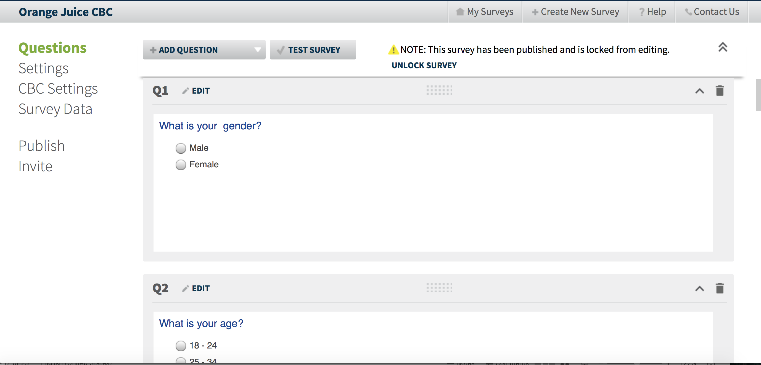
Discover Survey Setup
Data Preparation:
Established rating questions to collect demographic data
Age and gender questions
Build the survey structure by entering in all attributes and levels from the chart
Set preference order and prohibitions to optimize the deign and number of questions presented
Design Survey Questions
Notes:
Creating the Survey in Discover was fairly simple. I did have to do some configurations and set some prohibitions in order to make optimize the design or the number of concepts presented will be quite large
I first created some survey questions
Next I pulled in all the attributes and levels

Slide 13
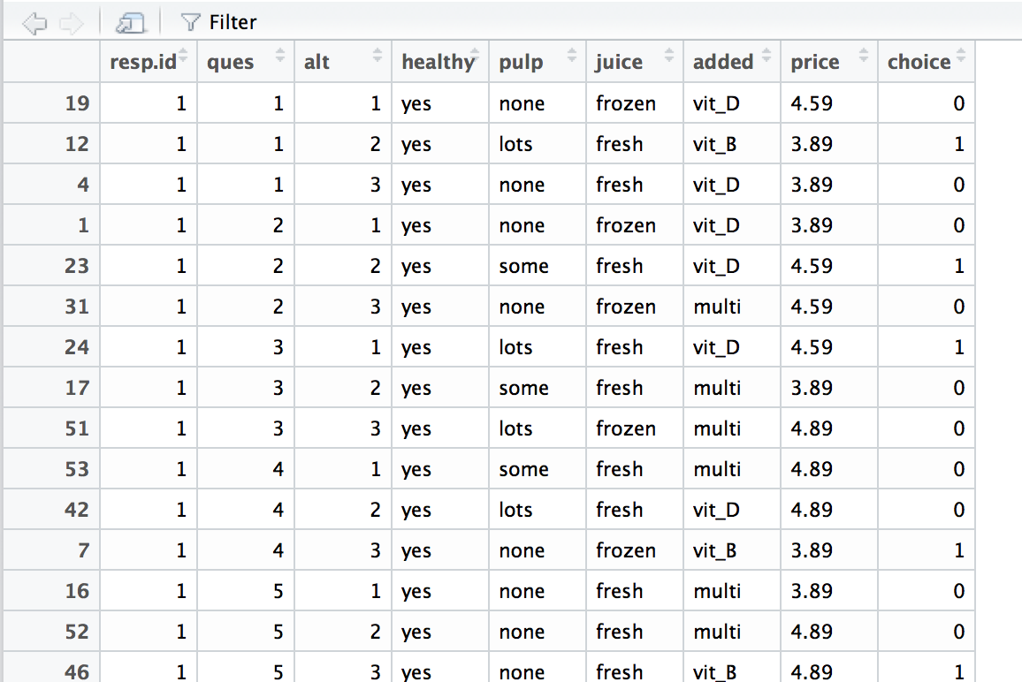
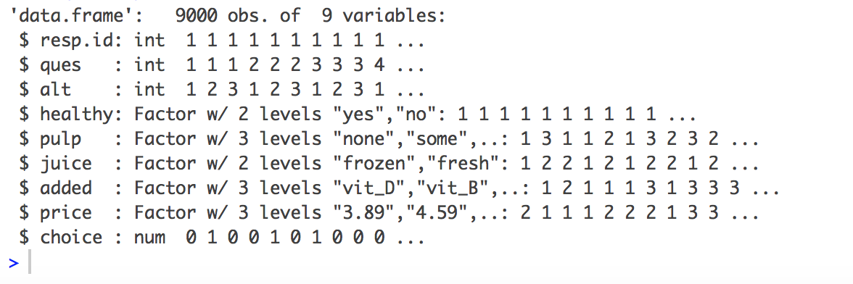
Simulated Survey Dataset
Data Preparation:
Created a hypothetical data from a conjoint survey using a subset of the OJ attribute and levels
pulp = c("none", "some", "lots")
juice = c("frozen", "fresh")
added = c("vit_D", "vit_B", "multi")
price = c("3.89", "4.59", "4.89")
cbc.daf contains 9000 rows and 9 columns
Each Respondent answered 15 questions and each question offers three alternatives to choose from, which is a total of 15 × 3 = 45 product profiles
Format the dataset for mlogit into either long or wide format
cbc.mlogit <- mlogit.data(data=cbc.df, choice="choice", shape="long", varying=3:6, alt.levels=paste("pos",1:3), id.var="resp.id")
Survey Data Structure
Notes:
The data was set uses the same attributes and levels as Discover.
The data format options are wide and long. For this I experiment choose long format.
As you can see. I highlighted the first question that was asked of respondent 1- The choice column shows what the respondent chose the second alternative. which was – Lots, Fresh, Vitiamn_B and $3.89

Slide 14
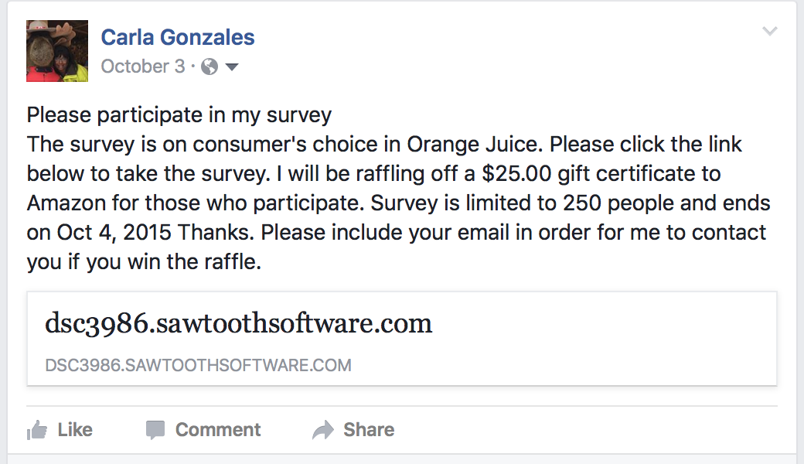
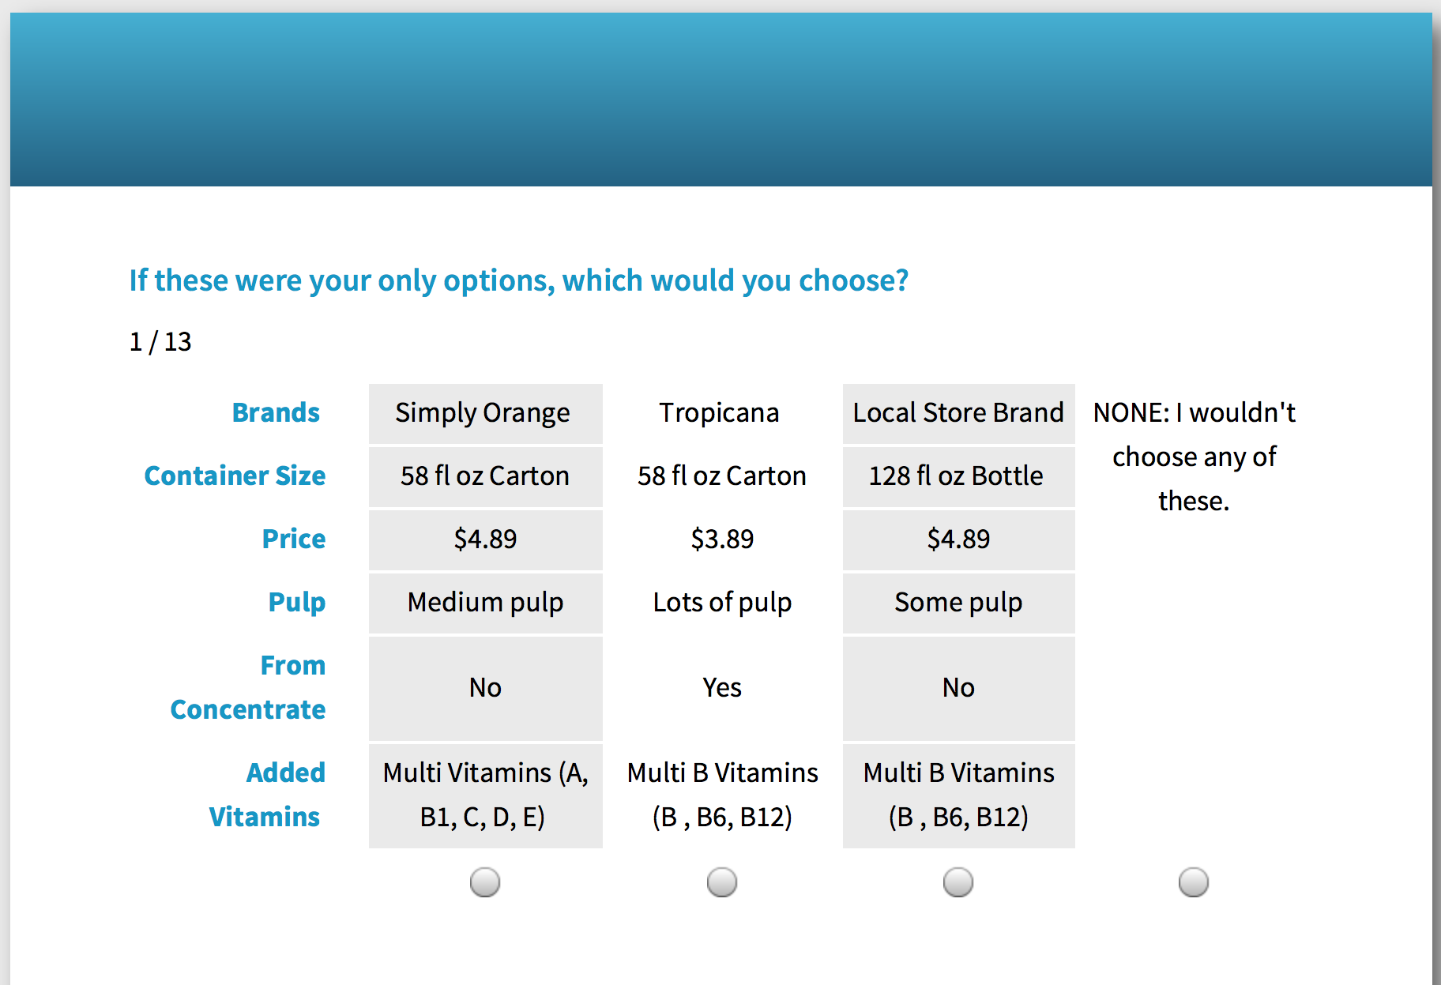
Posting the survey
Implementation:
Discover
Before launching the survey to the public, a test survey was run to confirm the survey was done correctly
Posted the survey link on Facebook
Offered an $25.00 giveaway incentive
The incentive did not impact respondent turnout
Notes:
Once the survey was setup. I ran a test survey to confirm the concept designs and choice sets were implemented correctly
Next, I posted the site on my Facebook page and offered an incentive for respondents to complete the survey

Slide 15
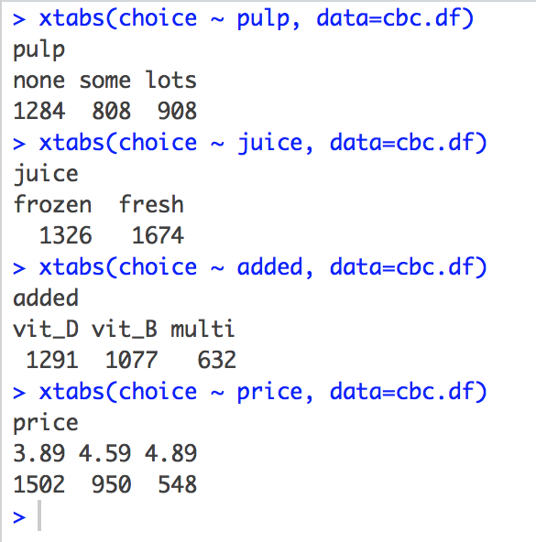
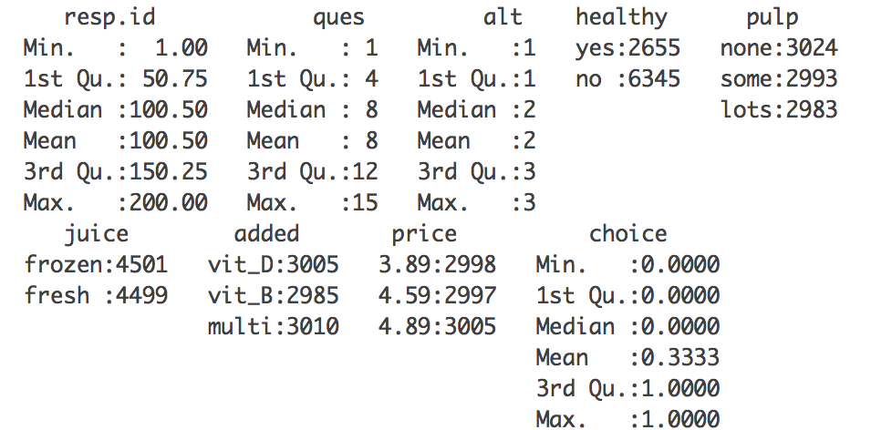
basic descriptive of the data
Implementation:
Before fitting the model the data was evaluated
Run a summary analysis give you an idea of how each attribute appeared in the survey
Summary(cbc.df)
Choice count was computed to determine how many times respondents choose an alternative
xtabs(choice ~ pulp, data=cbc.df)
xtabs(choice ~ juice, data=cbc.df)
xtabs(choice ~ added, data=cbc.df)
xtabs(choice ~ price,data=cbc.df)
Notes:
I first summarize choice data is to compute choice counts for each alternative using xtabs()
Notice that Respondents
Pulp none, Frozen, Vit_D best price 3,89 were all choose the most
Note: you can see that most of the attribute ran about 3,000

Slide 16
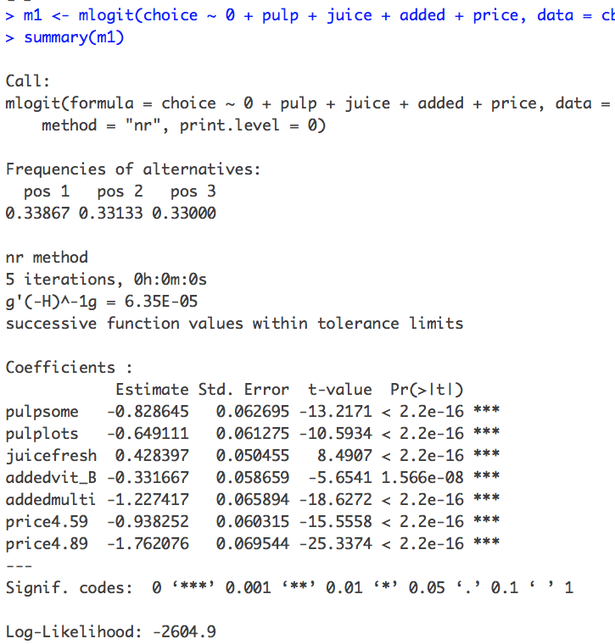
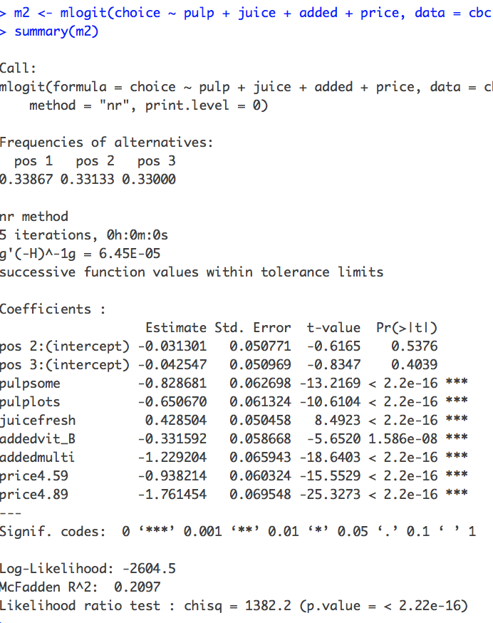
Fitting choice model with mlogit
Implementation:
Load and install libraries
library(mlogit)
Used mlogit() function to obtain the estimated part-worth coefficients
First model: uses 0 to not include an intercept
Second model: adds the intercept, which can check for question skewness
Models shows
Added-multi and $4.89 price are least preferred
It is not necessary to include intercept
Notes:
Mlogit (multinomial logit model) is the most commonly used choice model. Its also called the conditional logit
Estimate lists the mean values for each level (how attractive each
Std. Error determines how precise the estimate - a statistical test of whether the coefficient is different than zero.
Intercept parameter estimates are non-significant and close to zero.
Checking the intercepts --might be a indicate a good test to make sure respondents are not choosing the first or the last option without considering the questions.

Slide 17
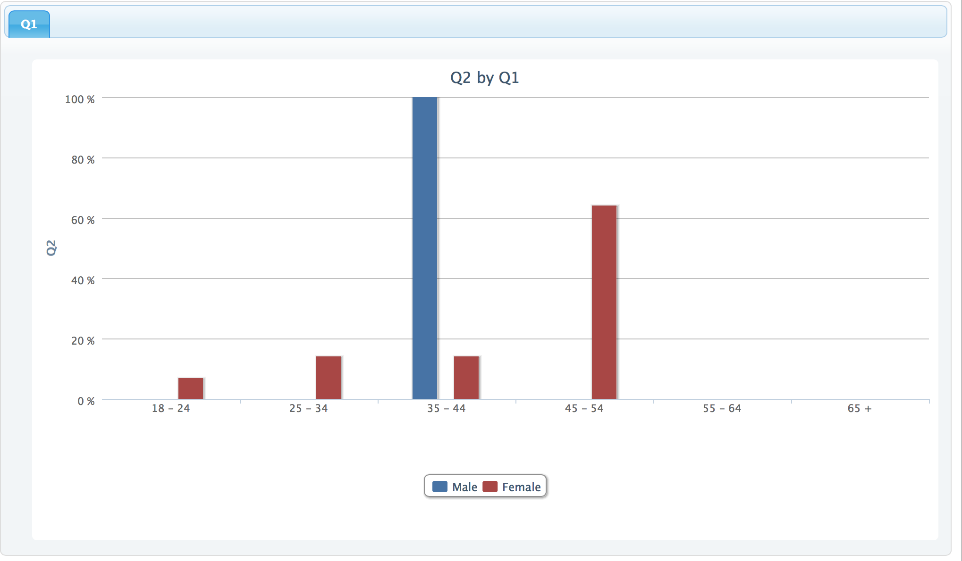
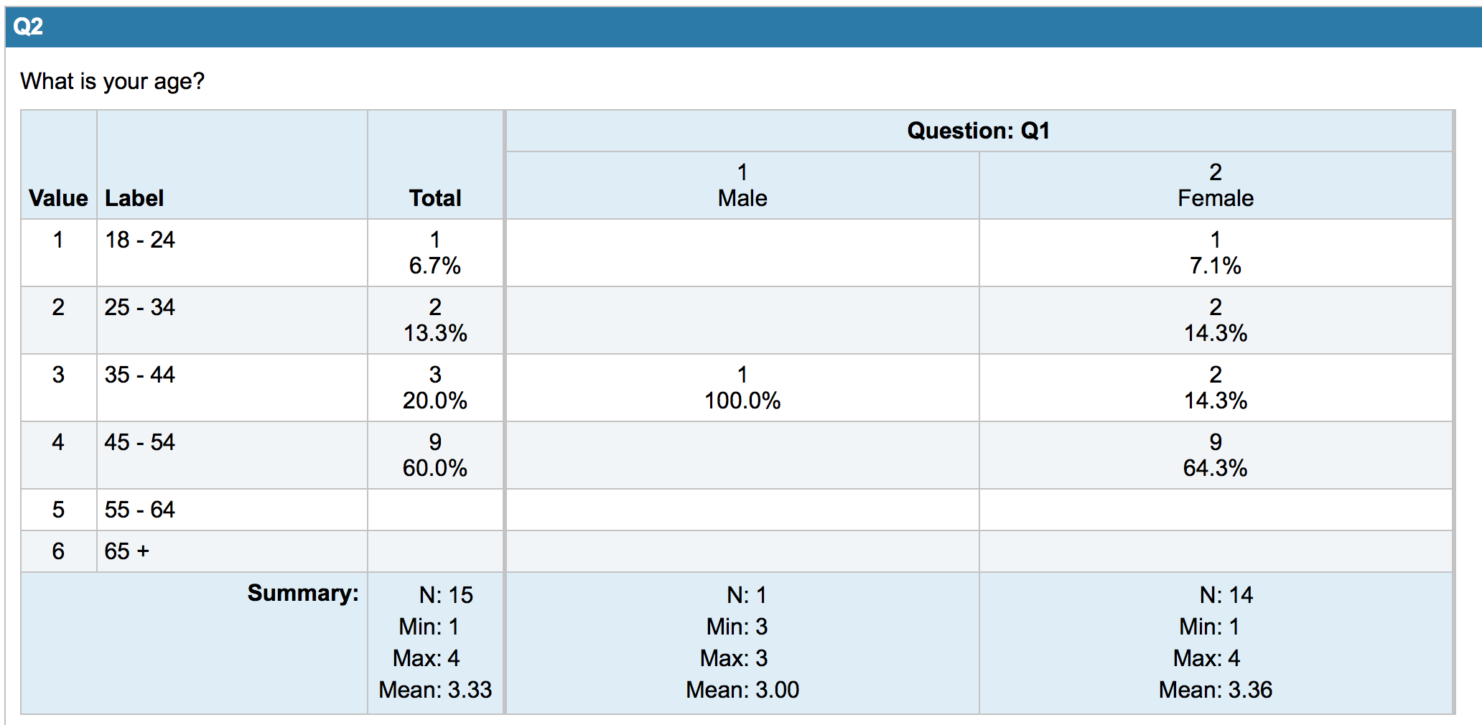
Discover Survey Results
Analysis:
Survey turnout was small, however, there was still enough data to generate adequate analysis
35 total with 15 completes surveys
13 questions, produced roughly 781 response records
Performance analysis
Can not measure Facebook click-thru or conversion rates
Survey demographic were predominantly
Female
Age 45 to 54
Notes:
Bit surprise by the turnout but I was still able to get good results.
Discover has a built in feature for analyzing data the CBC Simulator uses an Empirical Bayes modeling procedure,
which provides an individual level of estimation. Discover offers three types of outputs, which are:
Utilities
Importance
Market Simulations

Slide 18
Discover Utilities output
Analysis:
Measures the results of the attribute levels (alternatives) respondents prefer. Considers the probability of choosing one level over all alternative levels in an actual choice.
Key takeaways from this output shows:
Respondents have an strong preference for Minute Made with an equally strong preference for Simply Orange. Local Store Brand is less preferred
Respondents want to pay the lowest possible price. However, respondents are not as price sensitive between $4.59 and $4.89
Plant steroids were less preferred. Single vitamins such as D and Calcium were most preferred. This analysis brings insight into Respondents awareness of complex ingredients. The lack of knowledge can impact purchase decisions
Note: Utilities can not be measured across attributes, therefore it is not correct to evaluate a respondent’s preference in brands against their preference in added vitamins.
Notes:
To analyzing choice- base conjoint you would consider the attributes numerical part-worth utility
Which is a value that is computed for each level of each attribute.
Large part-worth utilities are assigned to the most preferred levels,
small part-worth utilities are assigned to the least preferred levels.
The attributes with the largest part-worth utility range are considered the most important in predicting preference.

Slide 19
Discover Importance output
Analysis:
View the differences each attribute makes towards the total utility of a product. The difference is measured in percentage of the best and worst attribute level
Interpreted as the range in the attribute’s utility values
This output provides insight into what attributes effects consumers overall decisions
Key takeaways from this output show:
The price, pulp and brand are fairly evenly distributed
Added Vitamins has slightly more importance as it has also the largest less preferred utility
Notes:
Ths output looks at the overall effect of each utility on consumer choice

Slide 20
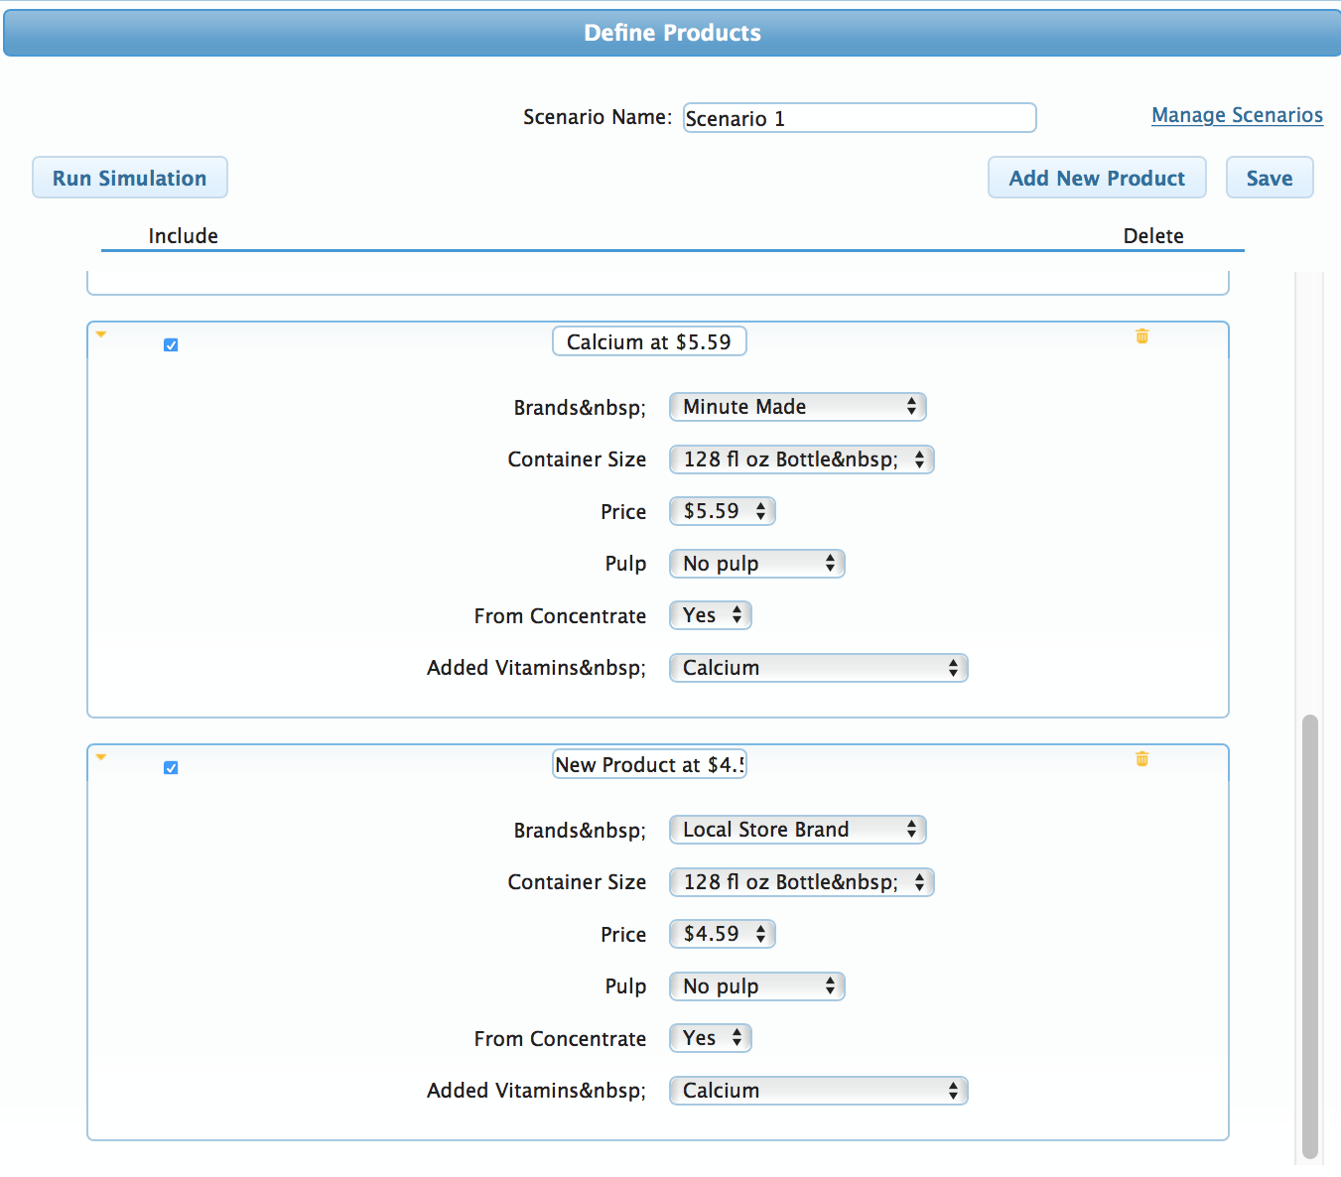
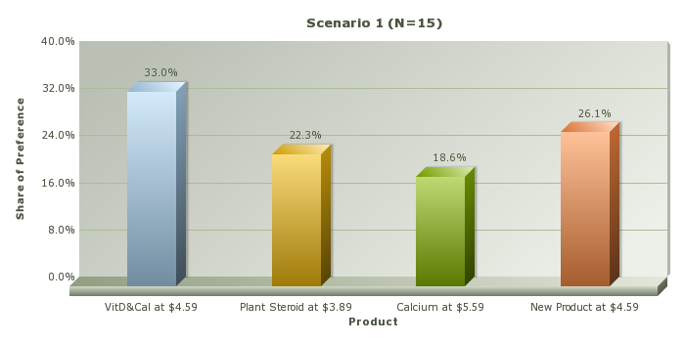
Discover Market Simulation output
Analysis:
Creates product scenarios, based on the total utility scores.
Key takeaways from this output show:
New product can capture significant market share when competitor prices are low
Vitamin additives have a big impact on market share
Notes:
This is where

Slide 21
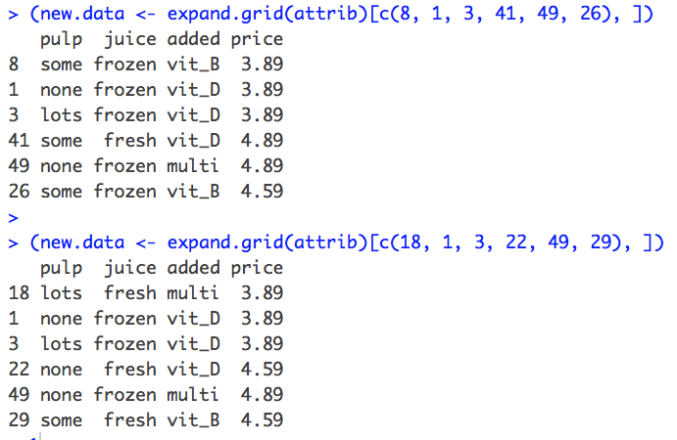
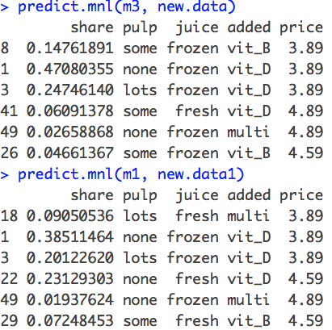
Predicting Shares with Mlogit
Analysis:
Share simulator helps define a number of different alternatives
the model can be used to predict how customers would choose among new alternatives.
expand.grid() create the full set of possible designs using and select the designs
respondents would choose frozen juice at $3.89 over fresh in mn1 about 14% of the time.
Notes:
Here you can see the same type of market simulation that show respondents are prefer frozen over fresh at a lower price point

Slide 22
New OJ product
Case Study Results:
New promotional orange juice drink, which will be sold in select markets.
Best marketing tactics for this product:
Potential target customers
Woman over 35
Target stable family environment (time for breakfast)
Best price point
Between $4.50 – $4.89
Price should reflect quality of juice. Fresh squeezed is valued more than frozen
Capture competitor’s market share
At least 30%
The new product mix
128fl oz. bottle, Fresh Orange Juice with Vitamin B12, an important protein vitamin contributing to overall muscle mass and growth, suggested retail priced $4.79
Notes:
Choice-based conjoint analysis provides excellent estimates of the importance of the features, especially in regards to pricing.
So the goal here is to use this type of analysis to estimate the value of each level in order to make the optimal product.
What product should be developed.
Right off we know customer are price sensitive so pricing the product 20cent above the preferred price – can work.
Offered 1 vitamin (B12) along with an explanation of its benefits
Fresh – None concrete (can’t say fresh squeezed as it is not actually fresh)
Market to women /potential family – Make time for Orange Goodness

Slide 23
Challenges and Next Steps
Conclusion:
Three major challenges:
Confused by the different choice models
Understanding experimental design
Data survey data formatting
Next Steps:
Redo the experiment using other choice methods or weighted survey models, such as
Full-Profile Conjoint Analysis
Adaptive Conjoint Analysis
Max-Diff Conjoint Analysis
Notes:
Working with live survey data – in to correct format from different programing's

Slide 24

References
Conclusion:
A complete list of references along with detail articles about conjoint analysis, Sawtooth Software Discover and Mlogit are available on my blog deepwaterdatascience.com
Data and support files for this project is available on my Github site
Notes:
Useful References
Business Insider, Orange juice is being called a massive scam — and now it's disappearing from breakfast in America, Hayley Peterson, Oct. 13, 2016
Https://www.surveyanalytics.com/choice-based-onjoint-analysis.html
https://www.qualtrics.com/wp-content/uploads/2012/09/ConjointAnalysisExp.pdf
https://help.xlstat.com/customer/en/portal/articles/2062347-choice-based-conjoint-cbc-in-excel-tutorial?b_id=9283

Slide 25
Thank you Questions

